Slide 1
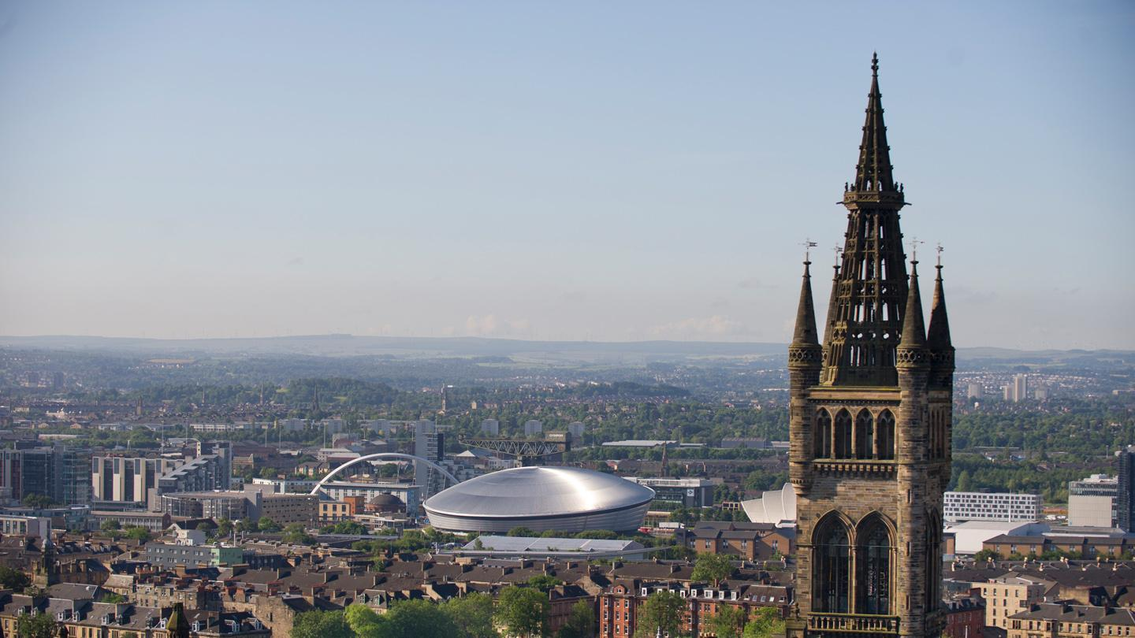

GlasGO
Level 2 Student Project
Web Application Development 2
School of Computing Science
2020/2021

Slide 2
Overview
GlasGO is a social media web app that allows users to share their social lives in the Greater Glasgow area, and engage with the community at large
After creating their user profile, users can share image, text, and link posts onto the GlasGO home page. They can also comment on the posts of other users or their own, as well as show their interest by clicking on thumbs up button
Users can view the posts on the home page from the top down, filtered by either Top (the most liked posts in the last 10 days) or Recent (the most recent posts)
They will also be able to mark their post as being of a certain category, such as events or cool spots, so that they or other users can filter the home page by posts from categories they particularly interested in
Anyone can enter and view the GlasGO home page, but they will only be able to post or interact with posts after they log in or, sign up and log in, to their new account
Users will be able to customise their user-profile with information about themselves such as their occupation or personal name (separate from their profile name)
GlasGO will also have an about page featuring information about the site, the team who develop it, as well as their contact information

Slide 3
Specification
Accounts:
All users must be able to create accounts
Logged in users must be able to edit/delete their own accounts
Users must be able to log in and log out of accounts
Viewing:
All users must be able to sort content, i.e., most popular and most recent
All users must be able to view posts (image, text, link) and comments
Interaction:
Logged in users must be able to like posts
Logged in users must be able to comment
Logged in users must be able to upload posts (image, text, link)

Slide 4

System Architecture Diagram
A comment or two might be needed?

Slide 5
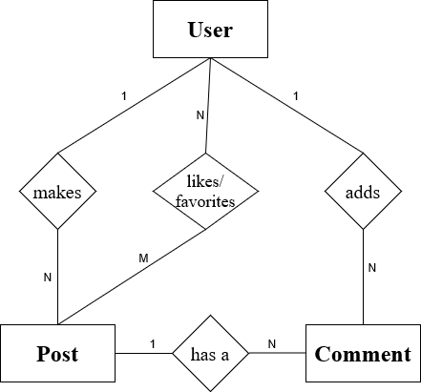
User
Field | Type
user_name | CHAR(32)
password | CHAR(64)
age | INT(16)
occupation | CHAR(64)
university | CHAR(32)
company | CHAR(32)
name | CHAR(64)
ER Diagram
Post
Field | Type
user_name | CHAR(32)
post_date_time | DATETIME
title | CHAR(128)
post_number | INT(128)
type | CHAR(64)
post_content | CHAR(2048)
category | CHAR(64)
no.likes | INT(128)
Comment
Field | Type
user_name | CHAR(32)
comment_date_time | DATETIME
comment_content | CHAR(128)

Slide 6
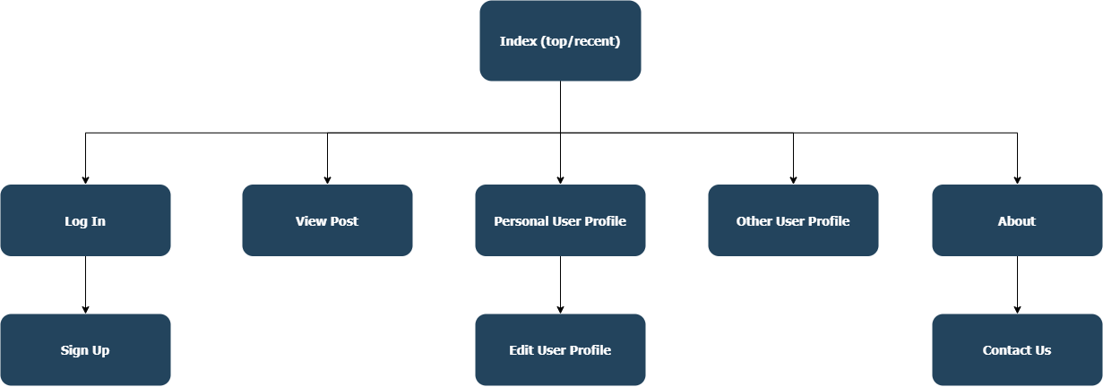
Site Map

Slide 7
Site URLs
/ (Index)
/login
/login/signup
/post/<post no.>
/user/<username>
/user/<username>/edit (must be personal username)
/about
/about/contact-us

Slide 8
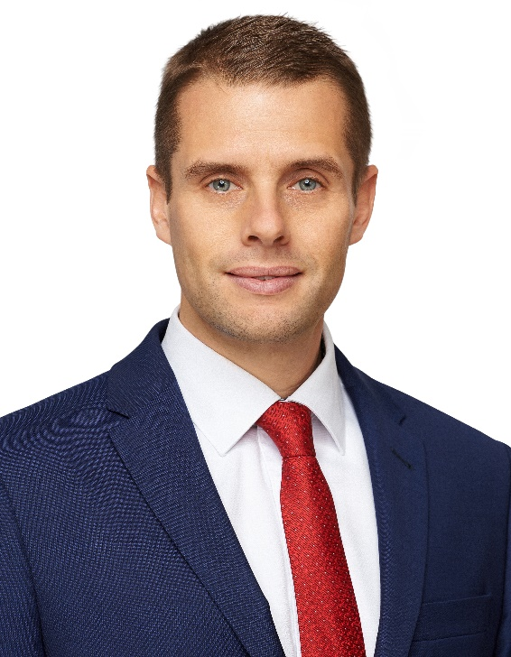
Persona 1
Bio: Just after he finished the Law School, Billy took a job in a small company, which provided law assistance in business law. Recently, Billy received a promotion to become a partner in this company. Ever since, he has been extremely busy and overwhelmed with work. Billy’s partners suggested for him to take a week off and to travel. He is going to spend it in Highlands; however, on his way back he wishes to stop in Glasgow for some cultural experience. He is not completely sure what he is looking for, he might enjoy a gig or a local market.
Name: Billy Smith
Age: 42
Location: London
Occupation: Partner in Law Firm
Status: Separated
Archetype: The Busy Browser
Goals: Using the time he has taken off efficiently, Billy has decided to create a structure for his upcoming vacation in Glasgow. Browsing through web pages with filtered content related to upcoming events and with local suggestions will help him realize this goal.

Slide 9
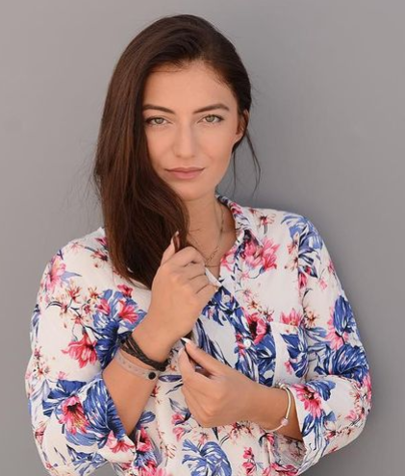
Persona 2
Bio: Last month Katie successfully finished her 2nd year at The Glasgow School of Art. She enjoys rather alternative music, and with her student budget she mostly spends her free time in the city on events that are free of charge but with a great spiritual value.
Goals: Katie and her friends often meet in a local pub where frequent pub quizzes are being held. As the community of pub quiz goers remains small and no new faces shows up, Katie would like to help organizers to spread the word and let Glaswegians know about this cool spot. She wonders whether she could find similar activities all around Glasgow since she has loads of free time during holidays.
Name: Katie Burns
Age: 19
Location: Glasgow
Status: Student
Occupation: Single
Archetype: The Art Student

Slide 10

Persona 3
Bio: Events4People Co. was founded in 2019 as a start-up of two friends from Edinburgh. At the university, they realized that they got stuck in their bubble of university students and they did not know many people outside the university. They started to organize small gatherings by the bonfire where everyone from town was welcomed, which resulted in big outdoor parties. They also helped to organize workshops in cooperation with the city council. They truly enjoyed this kind of job, left school and founded Events4People. On their portfolio, you may find a Rock festival in Stirling, a Let’s Talk About Science conference in Edinburgh, but also their original outdoor bonfire parties in Edinburgh.
Name: Events4People Co.
Location: Edinburgh
Occupation: Company
Archetype: Attention Seeker
Goals: As the company wishes to expand to the biggest city of Scotland, they are looking for ways to promote their already existing events. They are interested to see what people of Glasgow enjoy the most and what type of entertainment they usually seek.

Slide 11
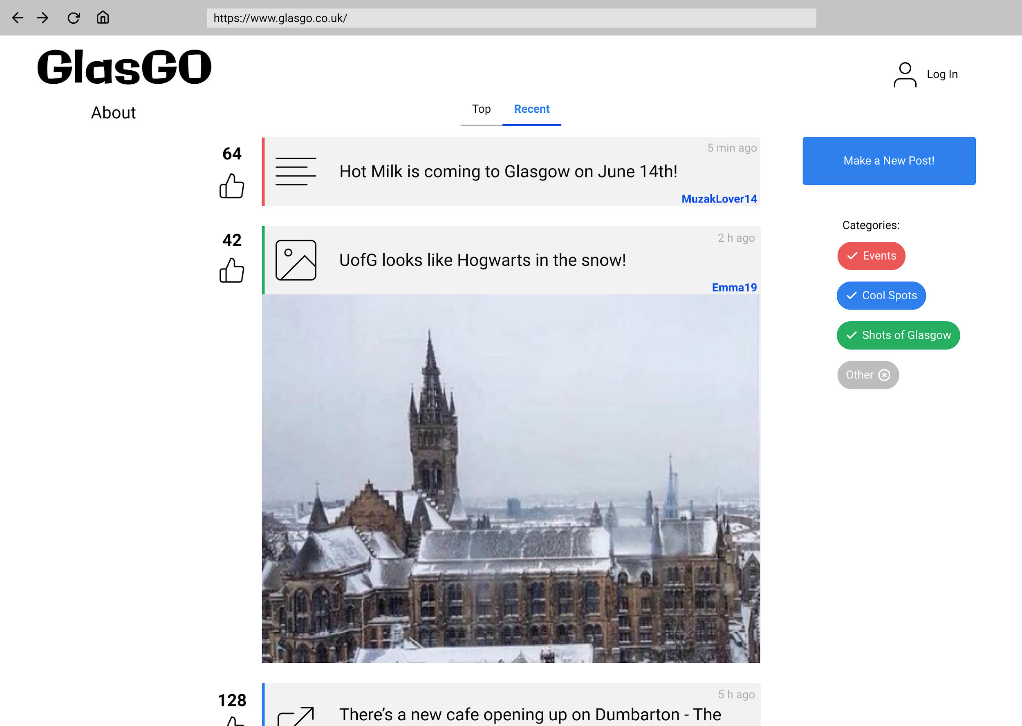
Wireframes – Index Page

Slide 12
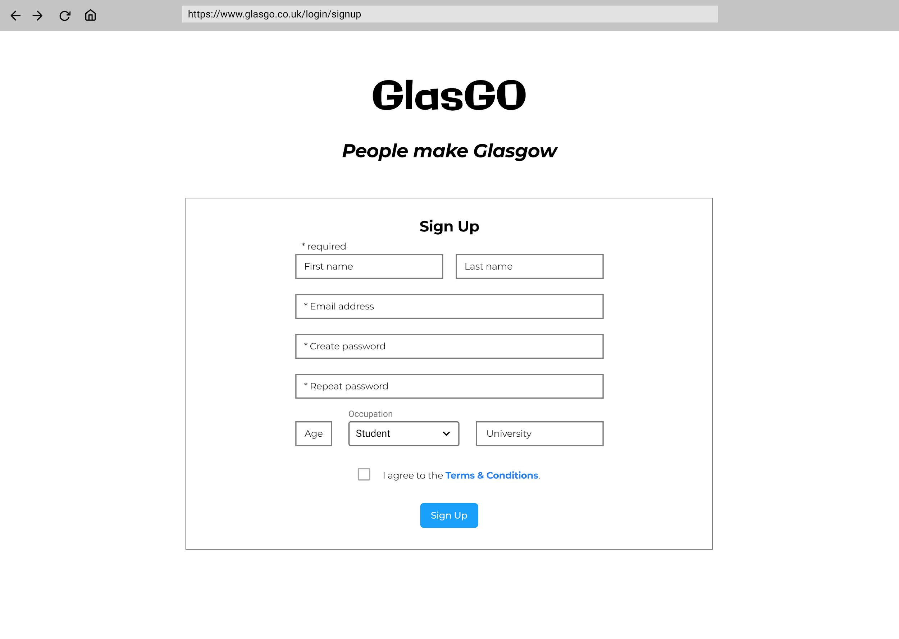
Wireframes – Sign Up Page

Slide 13
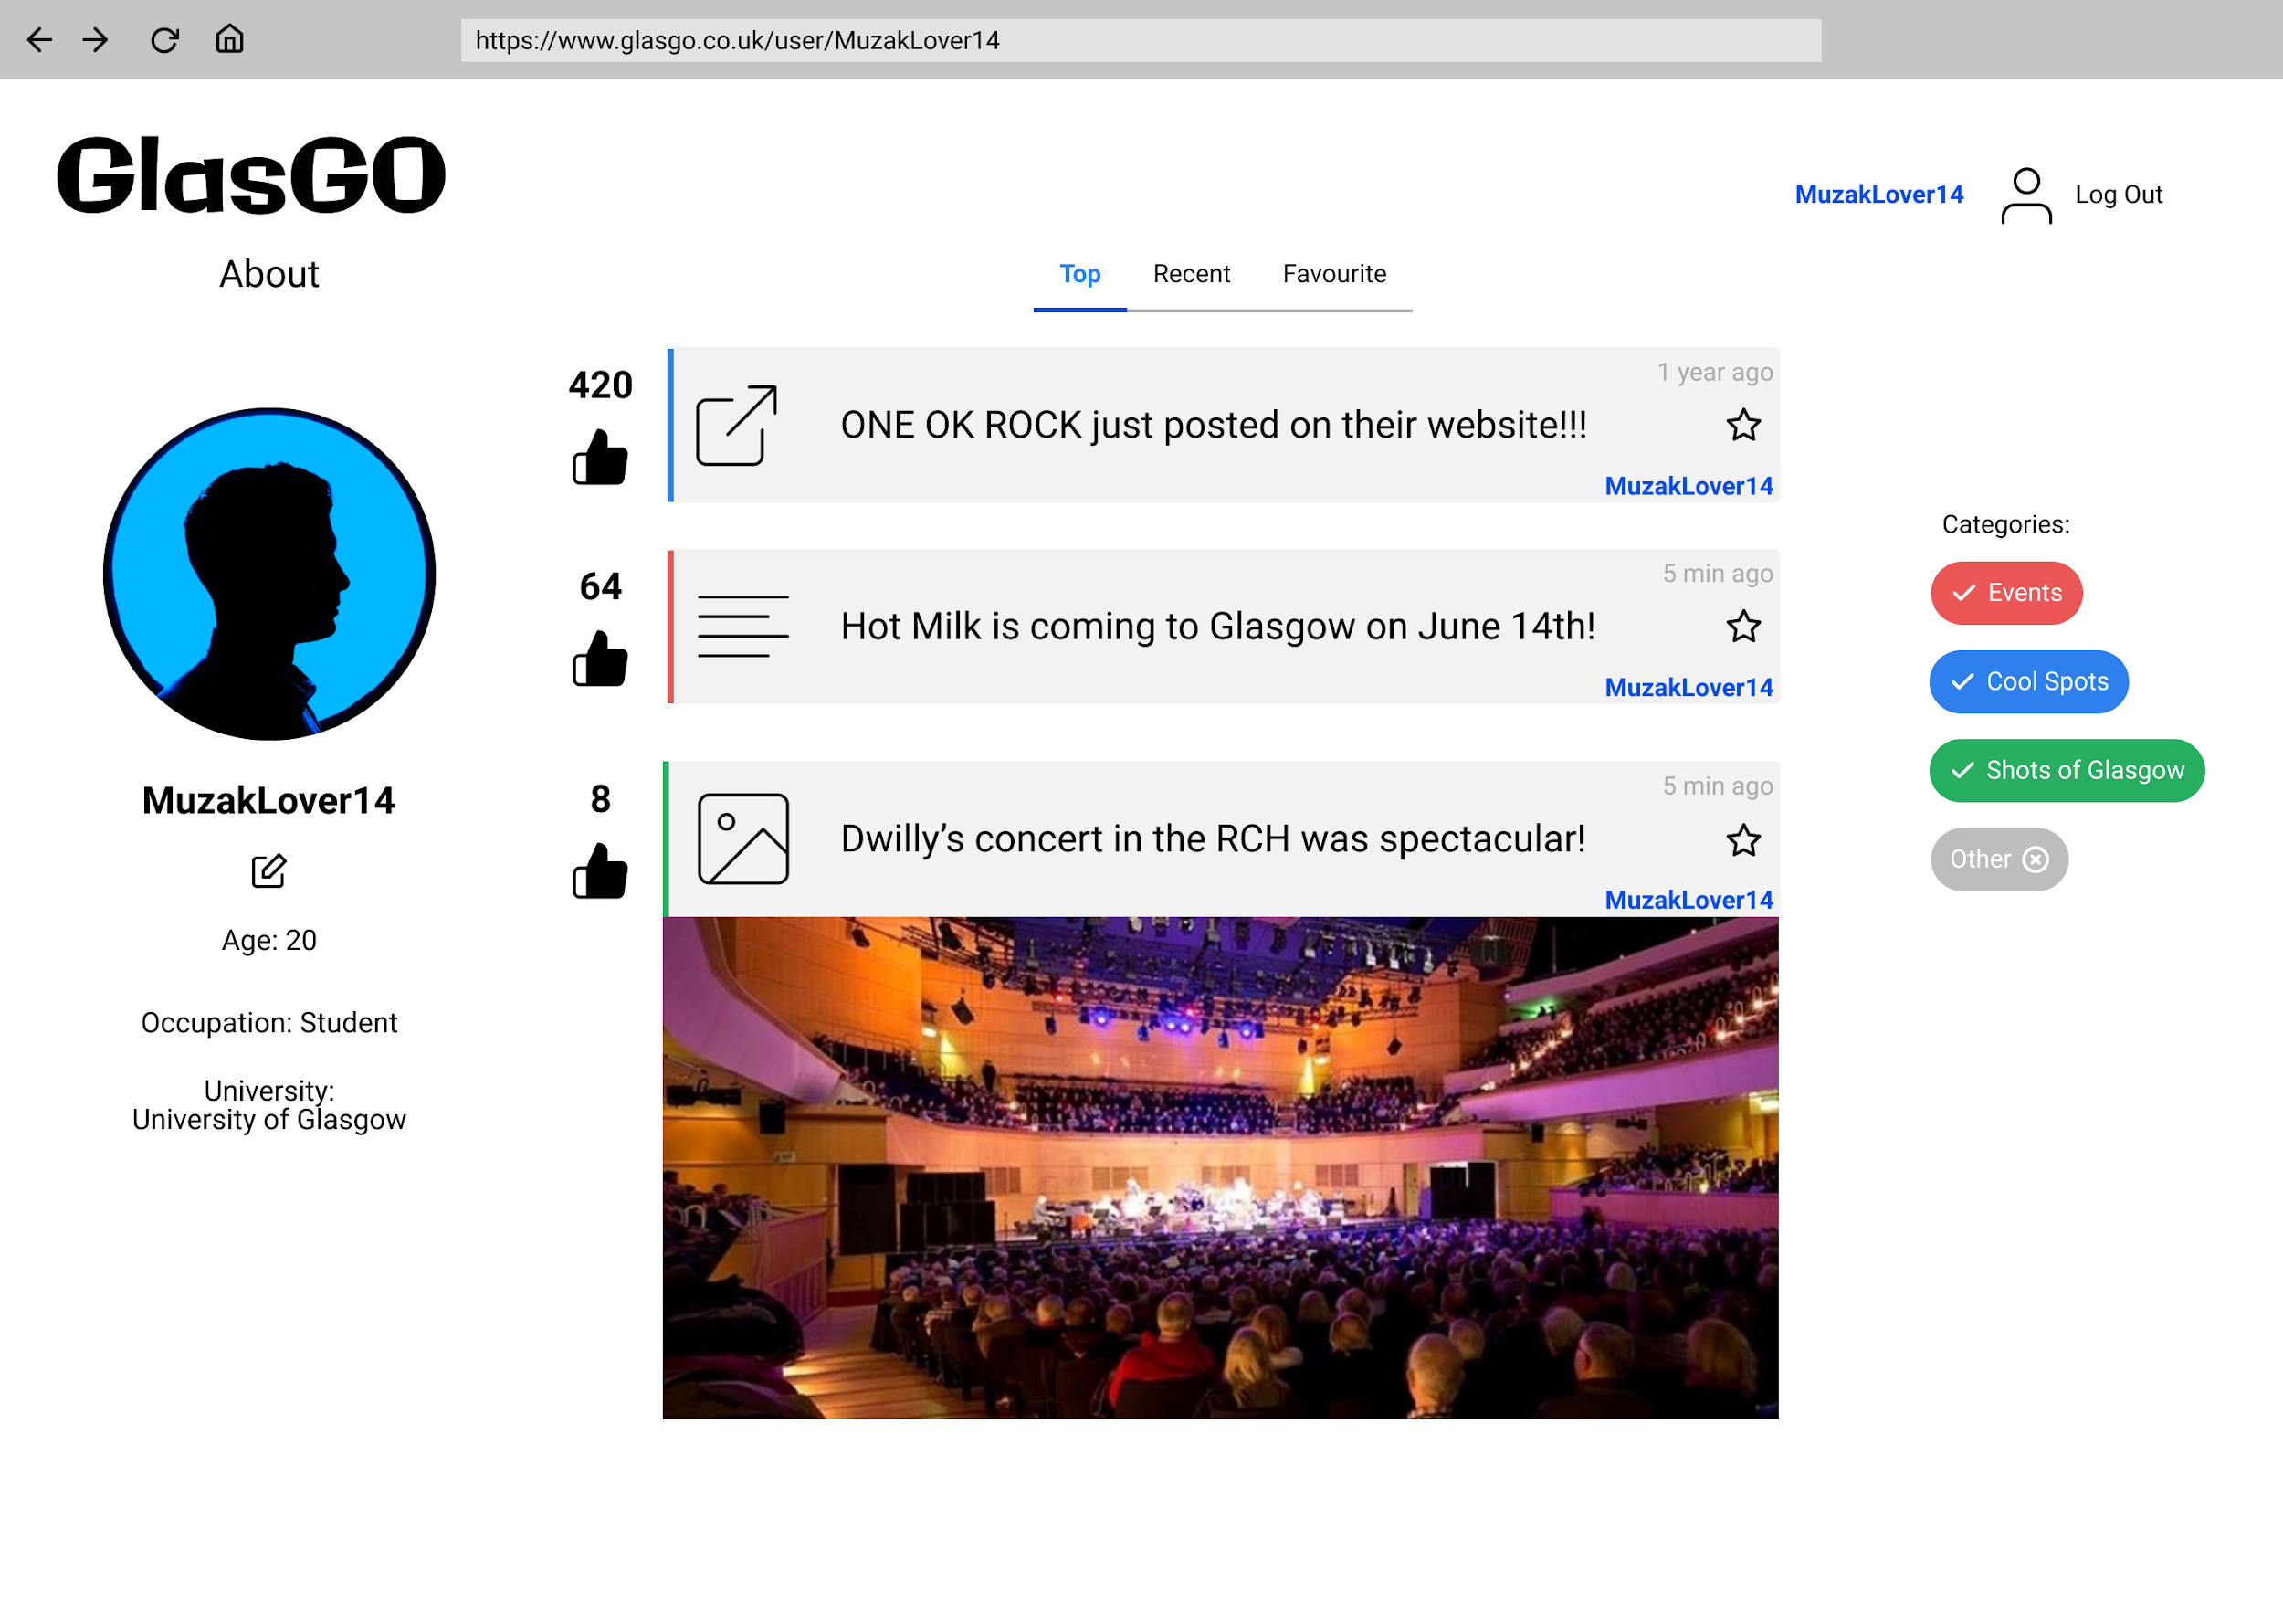
Wireframes – User Profile Page

Slide 14
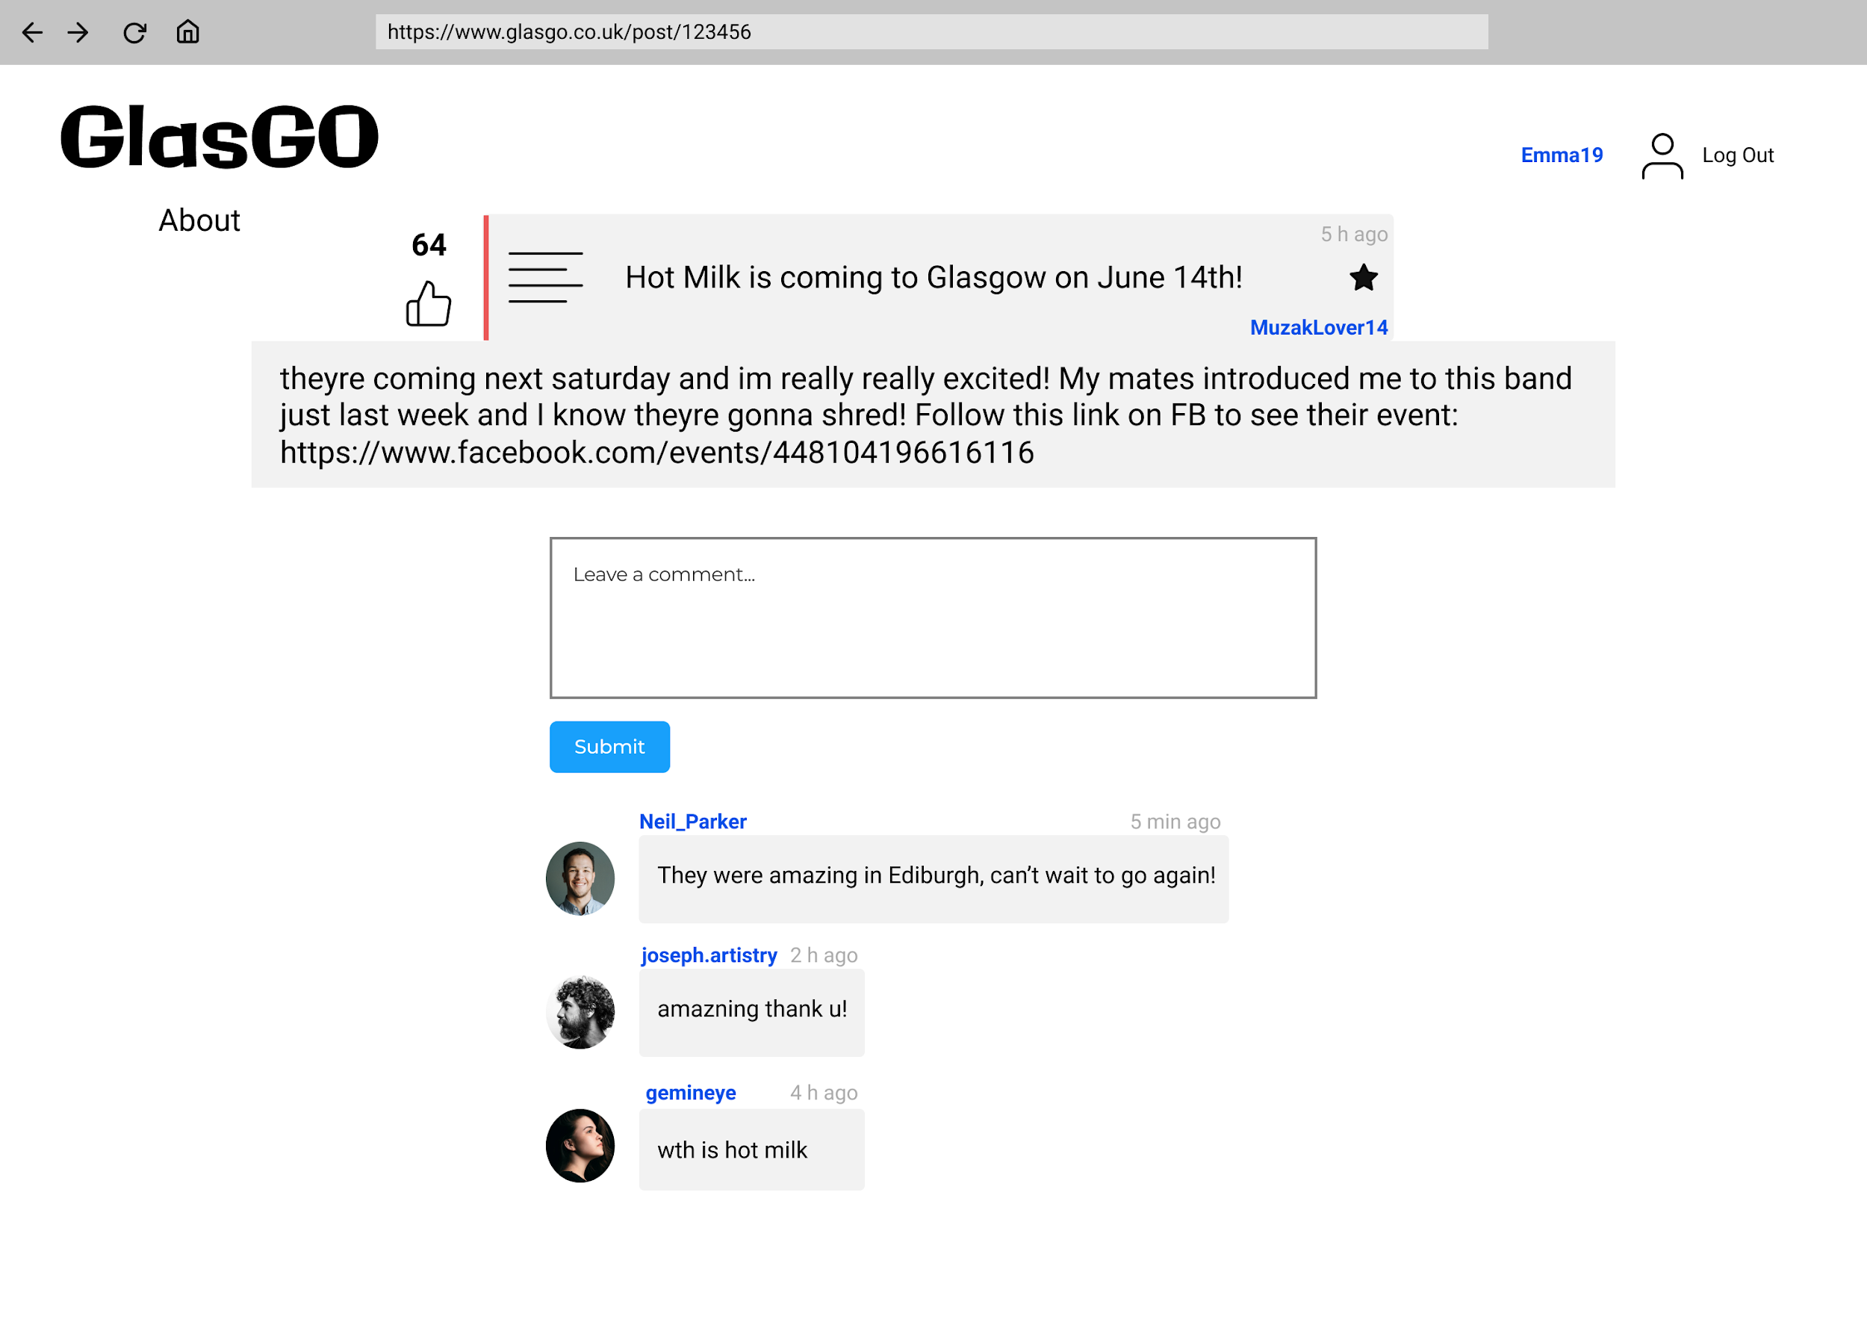
Wireframes – Post Details Page

Slide 15
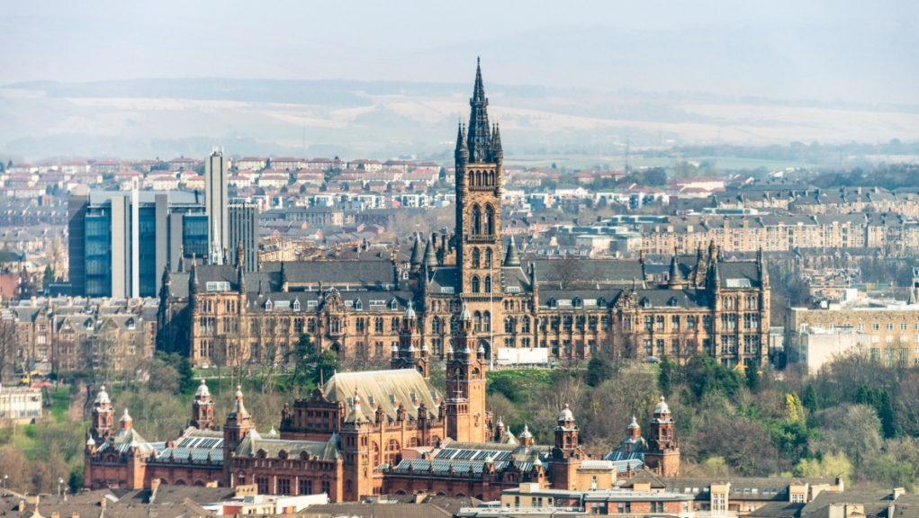
Any last words?
Simona Holubkova
Yanling Liu
Lewis McGlinchey
Karlis Sliders
2483856H@student.gla.ac.uk
2451921L@student.gla.ac.uk
2259138M@student.gla.ac.uk
2467273S@student.gla.ac.uk

